Slide 1
Storage
How it all works, under the hood…

Slide 2
The World View Before RDBMS
Application
Operating System (read/write)
Device Driver
Hardware

Slide 3
Storing Data in “the old days”
The simplest model possible was to dump your memory to disk.
Why is this good? Why is this bad?
Old isn’t that old - .DOC and .XLS do that…

Slide 4
Problems with using internal structures
When internal structures change, you have to migrate data
No one else can use the data unless they use your structure
No one else can use the data while you are using it (no safety)
Using your data requires a developer to write code
If/when your data has relationships, there is no enforcement

Slide 5
Idea 1 – File per table
This is similar to ISAM (which we talked about briefly in class 1).
When you define a table, a header with the metadata is written, then the bytes of the data are written out, fixed length.
This works but leaves a few issues:
It doesn’t work well with multiple users
Adding columns means re-writing the file (handled by the library)
Deleting columns leaves space in the blocks.
Relations are not enforced.
Example: dBase

Slide 6
Idea 2 – Create a single file for all the data
This allows relations to be enforced, but reduces our ability to have multiple users share the same data.
Within the single file, space can be better managed.
Example: Access (JET)

Slide 7
Better idea – Create a server
A server, in this case, is software – a program that accepts requests and processes them.
Req1
Req2
Req3
Database

Slide 8
The Basic View
Client PC
Server
Device Driver
Application
Operating System
Networking
Device Driver
DBMS
Operating System
Networking
Device Driver
Storage

Slide 9
Why is this better?
Works far better with multiple users – we now have a “traffic cop” to ensure that only one process is touching data at a time
We have a process that runs all the time
It can clean up empty space in its spare time
Caches better, since the data never gets flushed and caches are shared
Manages relations

Slide 10
Why is this better?
Dedicated hardware can be high powered, clients less so
Abstracts data access from software
Isolation layer means we can change databases or programs seamlessly
Easy to share data with others
More secure – single machine can be locked in server room

Slide 11
What’s the downside?
Dedicated hardware to run the server
More complex to administrate
Cost (maybe)
Single point of failure
Clustering/backups can help with this
All of these problems can be fixed with a little more money.

Slide 12
How Does It Work, Under the Hood?
I will use SQL Server as an example; conceptually, most implementations are very similar.
All (modern) databases start with files – one or more per database.
Why more than one?
That’s an interesting question…

Slide 13
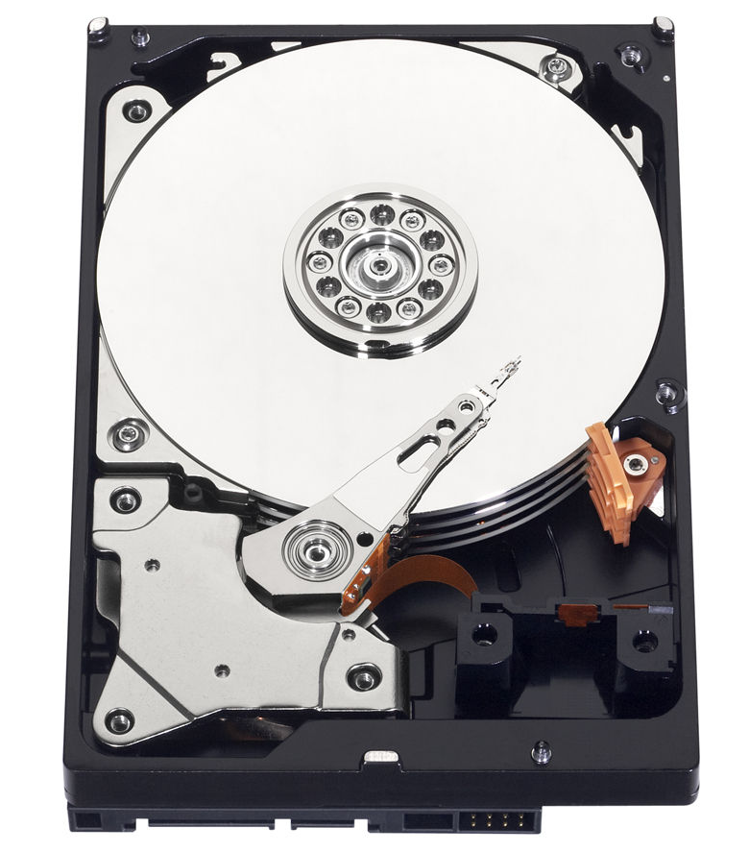
Hard Disks
The arm of the disk has to seek (move to) the point on the radius where the data is. This can take a (relatively) long time. Multiple disks mean more parallelism.
Of course, with SSDs, this is no longer quite as necessary.

Slide 14
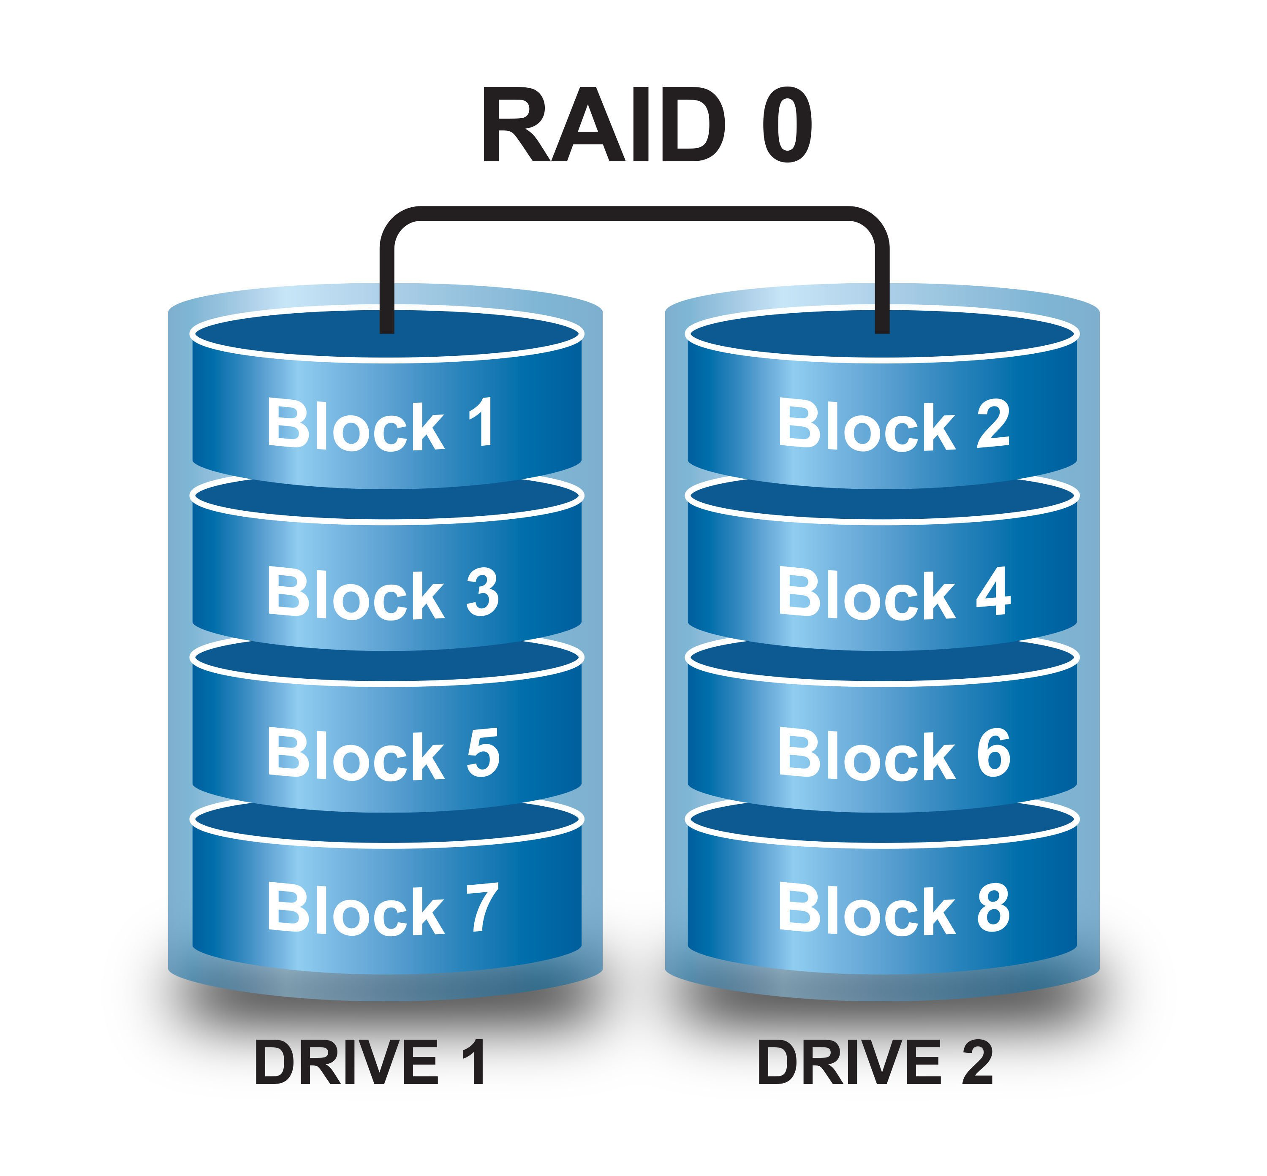
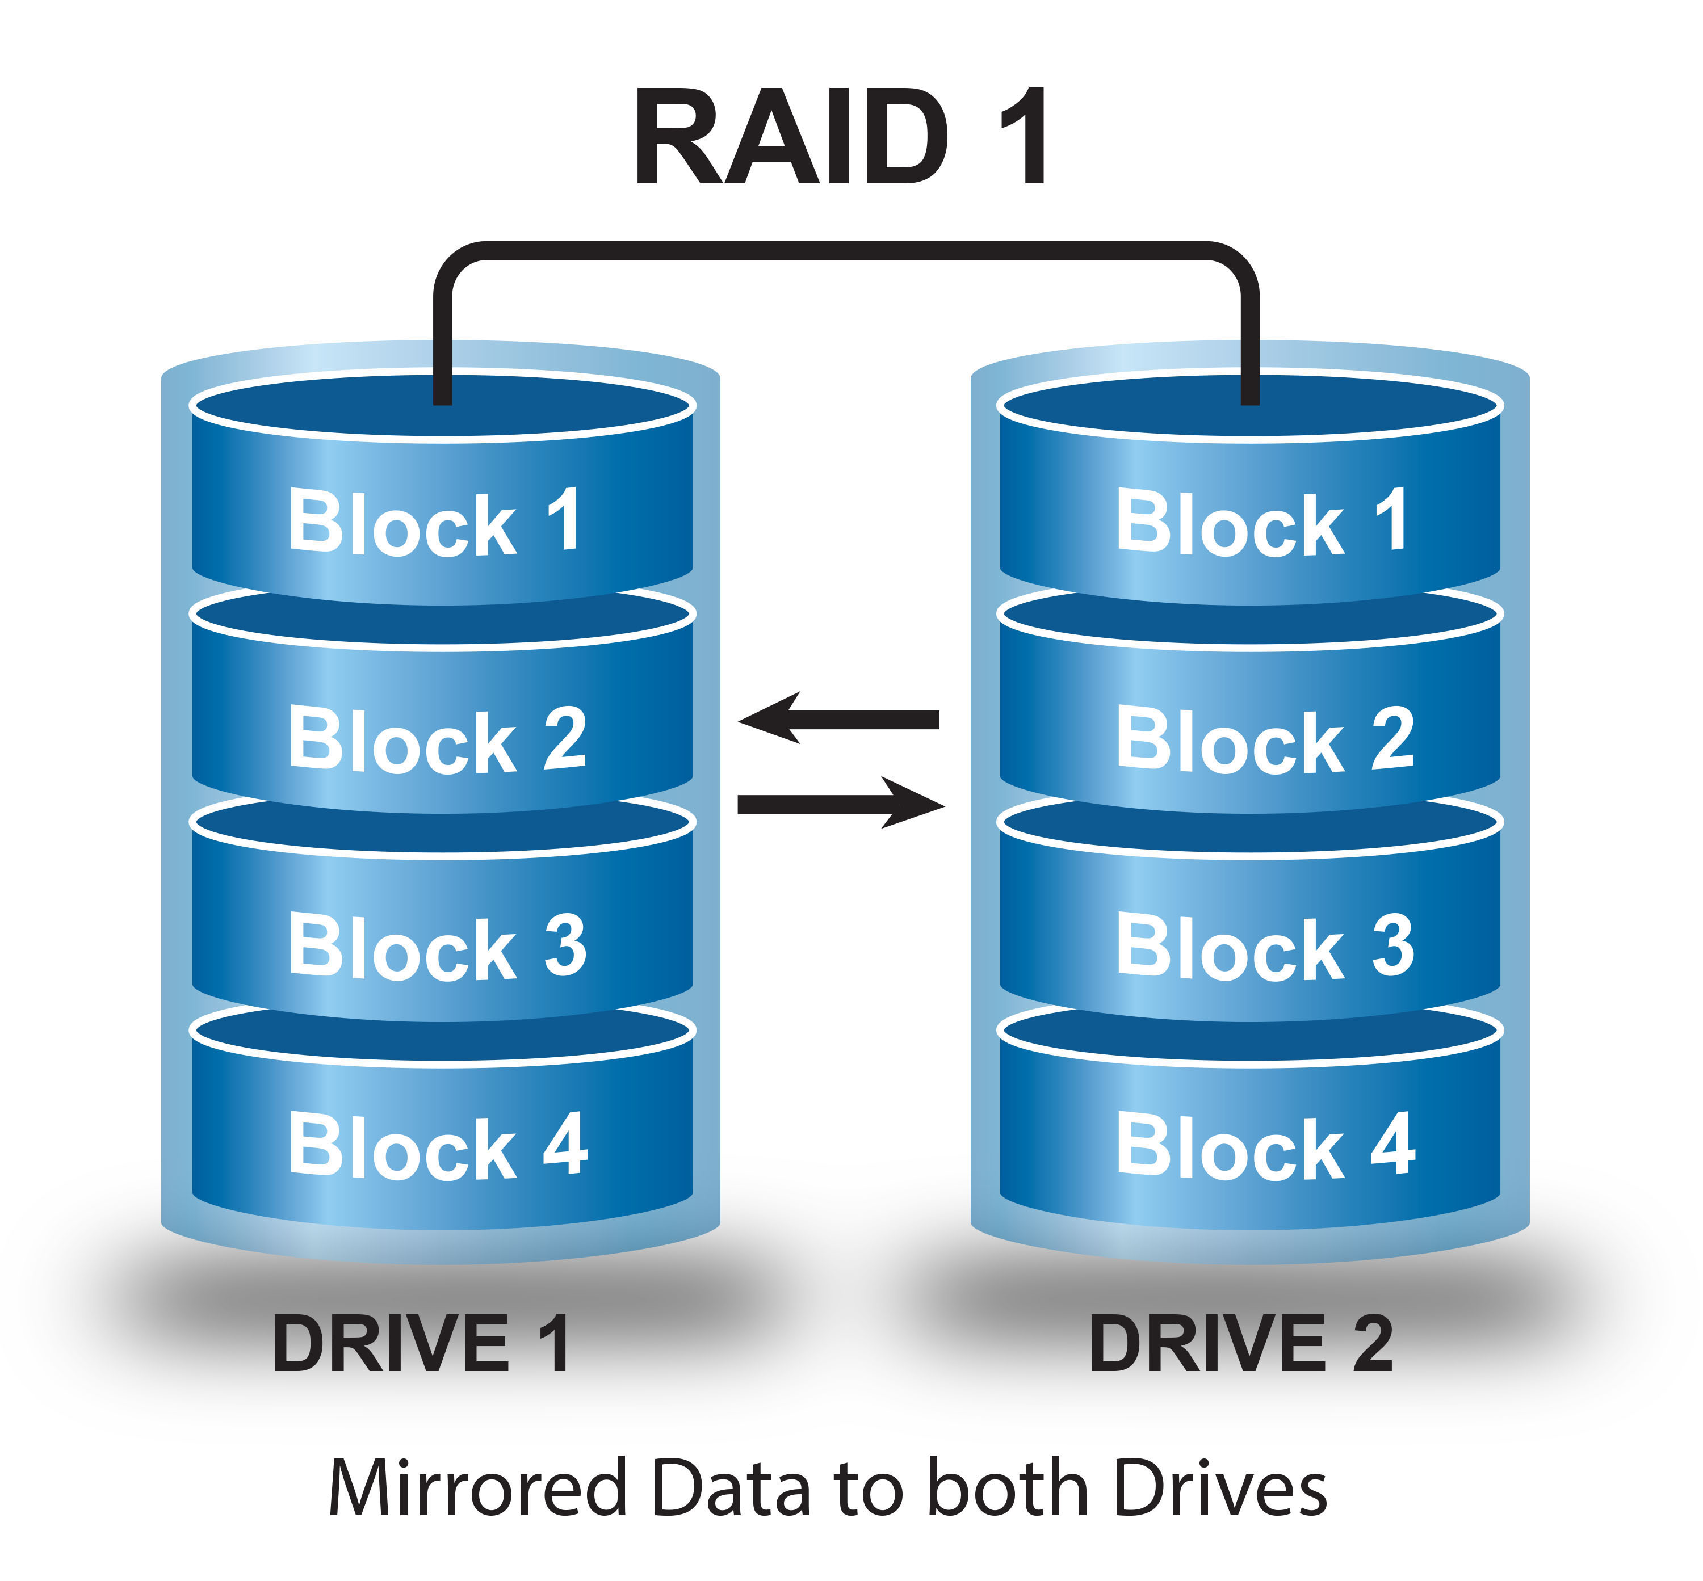
RAID 0 & 1

Slide 15
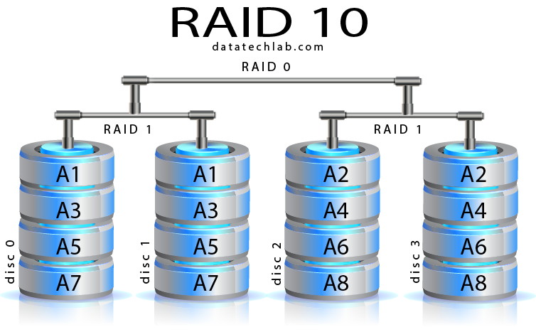
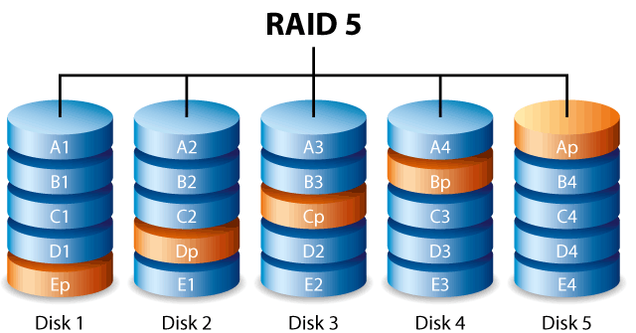
RAID 5 & 10

Slide 16
SSD
Solid State Disk – same idea as a flash drive
This technology is still evolving and finding good, modern performance numbers is hard.
Old (2011) data shows that SSDs are, depending on the work load, 5x faster than an array of 8 hard drives.
They have become so cheap and so large that it is a foregone conclusion.

Slide 17
Inside the file
The file is divided (logically, not physically) into pages. The database doesn’t track all of the pages, though. They group 8 pages into an “extent” and track those.
The first page in the file is a file header, containing database name and information about the whole database.
Following that are bitmaps of free and used extents. There is also an internal allocation map. This shows which extents hold which objects.

Slide 18
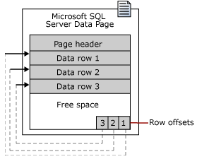
Inside the file
A data page contains a header and data rows. Rows don’t cross pages, but pieces of a row that are too big can be moved to other pages.
Notice the row offsets. Why do we need those and why are they at the end of the block?

Slide 19
How does this system work?
Slightly simplified – the database server tracks the databases that are “attached” – that it “knows” about.
Each database file, with it’s file header, has a page pointer to its system tables. The system tables hold the names of all of the tables, the names of all of the files, and the mapping between the two.
So, if I say “select * from mydatabase.myschema.mytable”, SQL Server looks in the attached files and finds “mydatabase”. It opens (if not already) the primary file for mydatabase and looks at the system tables to find myschema.mytable. That will tell it the file and the extent number to find mytable. The index allocation map will show the second and subsequent extents.

Slide 20
That sounds like a lot of indirection
There are some lookups involved in mapping an object name to its disk location.
But, what we haven’t taken into account is the cache.

Slide 21
Cache (a little operating systems…)
Database
Operating System (read/write)
Device Driver
Hardware
Page Cache

Slide 22

But wait, there’s more…
SQL Server ALSO has its own cache, the buffer cache.
It’s default behavior is to hook into Windows and monitor memory. It allocates all of the memory that it can, then gives it back when Windows is running low.
Remember, generally, this runs on dedicated hardware.

Slide 23
Why have 2 caches?
The operating system, operating at a lower level than the DBMS, doesn’t know anything about tables or databases. It only knows that it has pages of memory mapped to pages on disk.
SQL Server, on the other hand, has a LOT more information to work with. It can do a much better job of deciding which tables need to remain in memory than the operating system does.
Also, the 32 bit version of SQL Server did some extra work to support > 4gb servers.

Slide 24

Storage Roundup
The DBMS will handle a lot of details for you; You should know, though, what it does and why
Data is written to pages which hold rows
SSD has made arrays of disk and scattering your database files to multiple disks far less important

